Slide 1
Kloud Kart’s Data Plan: fix three problems before building anything big
Prepared for Nana Adjei | Grant Sarfo Darkwah
12 November 2026

Slide 2
Three Problems are costing us now
1. The shop slows down. Monday downloads slowed it twice last month.
2. Customer details are copied with no count. Marketing’s list alone holds 300,000 people.
3. Two sets of numbers. Operations and Finance reports never match.
One cause: nobody decided where data lives or who can take it out

Slide 3
Slow shop, oversold orders and wasted hours cost about GHS 100,000 a year
Slowdowns: about GHS 50,000 in lost sales
Oversold orders: about GHS 36,000 in refunds, support time and goodwill
Rebuilding reports by hand: about GHS 16,000 in staff time
Cost ranges from GHS 30,000 to GHS 660,000. (involving legal fees)
Estimates. assume a GHS 50 basket and two one-hour slowdowns a month. To be confirmed with the developer

Slide 4
The urgent one: the Data Protection Commission complaint:
Deleting a customer in the shop does not delete the copies on laptops and in email.
Plan: lawyer confirms the real date by 20 Nov, every copy listed by 4 Dec, reply sent by 15 Jan.
This is cheap to fix now and expensive to ignore

Slide 5
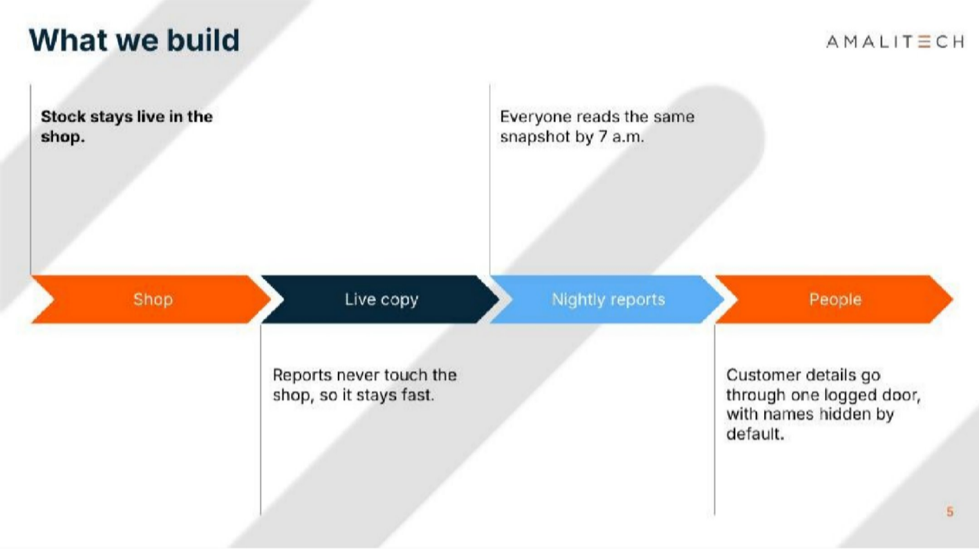

Slide 6
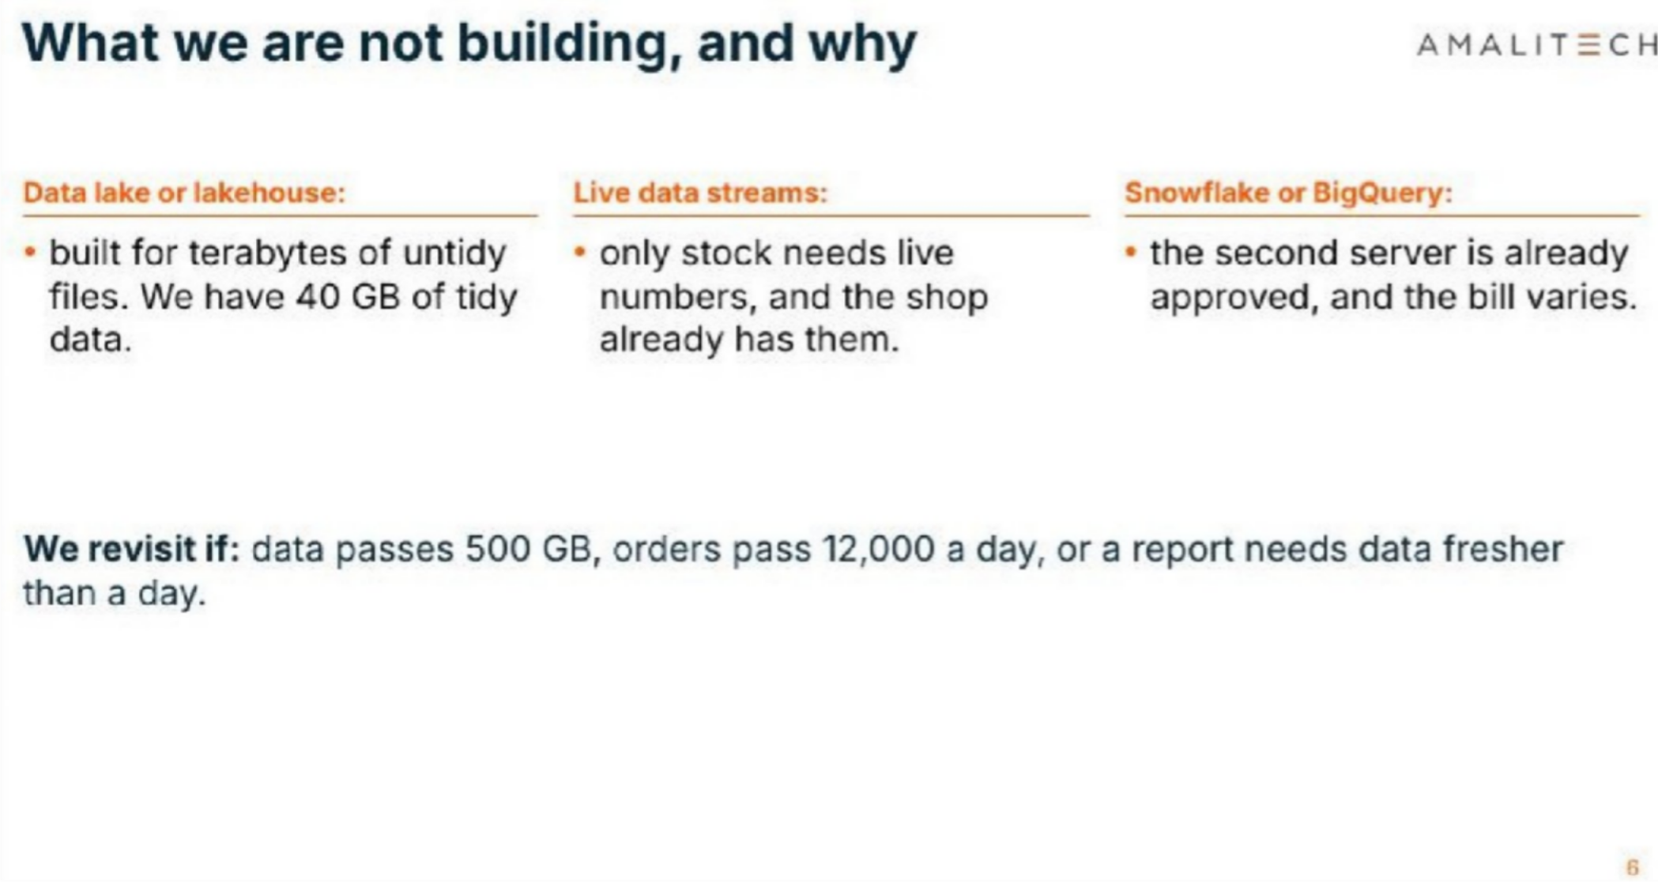

Slide 7


